Slide 1

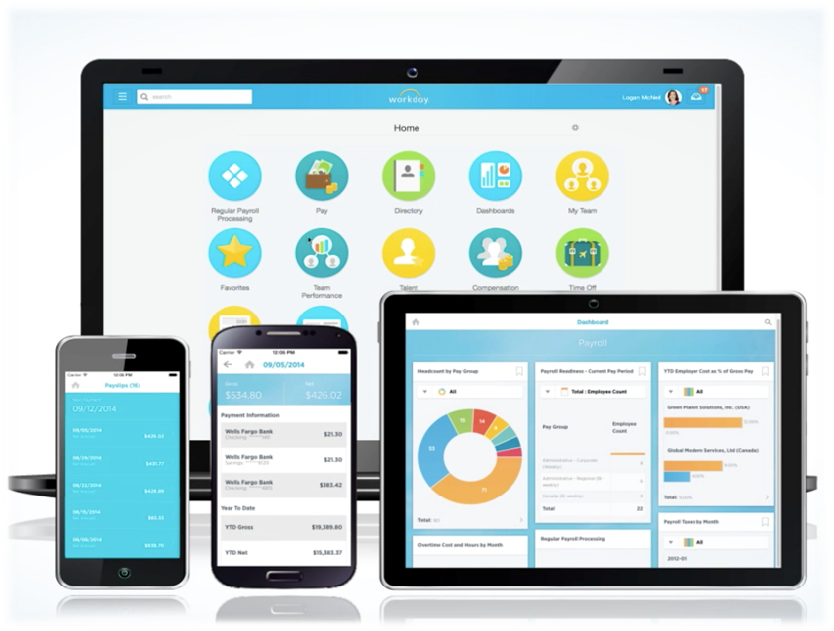
Workday at CMSD
Employee Self Service
for RSPs
October 2016

Slide 2



Welcome to Workday at CMSD!
Cleveland Metropolitan School District
Learning happens here
Increasing efficiency and effectiveness so we can maximize our focus on our students
Notes:
Welcome to Workday Training!
CMSD is a place where learning happens everyday…by our students in our school classrooms. And by our employees, finding better ways to do things.
Today we are learning to use elements of a new tool.
Why? To help us streamline processes and maintain more accurate data.
So that we can increase our focus on the students!

Slide 3

What is Workday?
…an HR, Payroll and Finance tool
that helps make people & processes
more efficient and effective
Notes:
An HR, Payroll and Finance tool to help make processes more efficient and effective.
Some Systems are Going away. Others have integrations with Workday.
Click on the Workday picture to play video.
How will Workday help? No MORE PAPER!!!

Slide 4














































The WHO of Workday
Who will be using the Workday system?
All of CMSD regular employees will use Workday, including substitutes.
Who helped build CMSD’s Workday system?
Thank you for your hard work!
Notes:
The WHO of WORKDAY
Who will use it?
All employees will use the system, including substitutes.
Who built it?
Not built in a vacuum—these people and many more helped configure it for CMSD needs. And we say Thank you!

Slide 5
WIIFM—the Workday benefits
Ability to Focus on Teaching and Learning
Current, Efficient & Effective Processes
Eliminates redundant processes and minimizes manual work
Breaking Down Silos to Improve Customer Experience
Integrated Systems: HR, Payroll, Finance & Procurement
One Source of Data
Fully Supported
Shift from technology support to academic enablement
User Friendly
Cloud solution
Aligns with The Cleveland Plan
Flexible, user- friendly reports
Promotes Collaboration
Improves collaboration
Improves Employee Self Service capabilities
Systems stay current
Enables Central Office to focus on key support and governance roles
Data transparency throughout the district
Timely and accurate information aids in school budgeting
Same data visible to all users
Notes:
SAY:
No matter where you are in the organization you will experience benefits of Workday.
We will all experience the benefit of having immediate access to data that is important to us. This data is private and secure in our own storage space. Additionally, the system is not driven by SSN, but EEID.
Talk about security here:
You may be wondering about who has access to Info--What info is available to people? What can my managers see about me?
What about other ees? What can I see about others?
Info about your role and work location is available for others in the org. Your personal info is not.
DO NOT SHARE YOUR PW WITH OTHERS—IF YOU DO, THAT PERSON HAS ACCESS TO ALL YOUR PERSONAL INFORMATION!

Slide 6


The Lesson Plan: Today’s Learning Objectives
As a result of this training you will be able to:
Navigate within Workday
View your payslips and tax documentation
Enter and submit your time worked
View Time Off balances and use Workday to request time off, if appropriate for your role
Here’s how we’ll do it:
Demo
Time Tracking practice activities

Slide 7
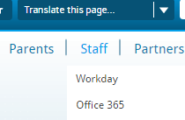
CMSD Workday Webpage
The CMSD Workday Webpage is a resource for you now and later!
From the CMSD web page,
select Staff > Workday
From here, you can:
Find videos and helpful job aids
Provide feedback
Log into the system
Notes:
It’s time to access the internet. Chrome is best browser to support Workday, but you can use any.
Introduce the Workday Website as a resource.
Go to the site and show:
Getting Started for Employees and Managers—a place to watch training videos and get job aids
Contact us tab—a way to provide suggestions and feedback to the project team
Training Tab>Log into Training System. The way to get into the system.

Slide 8
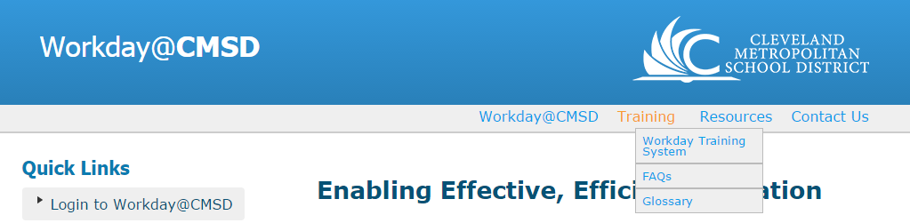
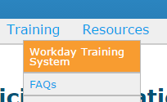
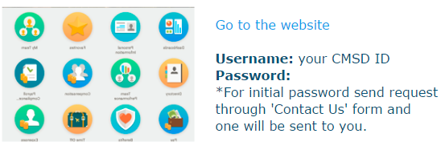

Let’s Log In!
Go to CMSD web page. Select Staff > Workday
  This takes you to the Workday@CMSD web page
Select Training tab at the top > Select Workday Training System
Click “Go to the Website”
Username is: your CMSD ID
Password is: Cleveland123!
z
8
Notes:
Getting to the Workday Training System from the CMSD Website. Staff > Workday > Training > Workday Training System
NOTE: THIS IS A TRAINING SYSTEM! (We are not training in the production environment, so no worries about messing anything up!) It is a place to play. This also means not all of the information that you see may be correct…we have used some of this info for testing.
To log in: Your CMSD USER NAME
Password: Cleveland123! (unless you have already logged into the training system and have saved you PW to something else.)
You will be prompted to reset your PW. Please write this down. You will need it for this training!
When we go live, you will use your CMSD Network PW and you not be prompted to change it automatically.

Slide 9
Navigating Workday
Learning Objectives:
At the end of the module you will be able to…
Navigate the home page
View key information on your Worker Profile
View and update your Licenses and Permits
Use the Inbox
Notes:
(7 min) Quickly demo items on the Home page: [See Instructions for Activity 1a]
SAY: “Welcome to the Home page where you can access all your personal information and much more. Let’s explore!”
SAY and SHOW these items:
Home button/Workday button —both bring you back home
Search —it is predictive, meaning it comes up with options that match what you type in
Actions/Related Actions icon —this button allows you to perform additional actions on an item
Worklets—these are apps with actions you can take or reports you can view.
View Inbox Worklet —Inbox has actions you must take, archives of past actions you have taken, and Notifications, including the status of business processes started by you.
We will look at other worklets in a moment.
Worker Profile —This area contains information on you and your job. Mention Action and Team.
View the Contact tab > Support Roles
Support Roles—these are the people who support you. Now if you need to contact your Absence partner or Compensation partner, you know who they are!
View the Career Tab > Certifications.
SAY:
“Use the Career tab > Certifications under your personal profile to view and update your Licenses and Permits at any time.
SAY FOR TEACHERS/PARAS/RSPs:
The Ohio Department of Education will send the teaching certifications of employees sponsored by the Cleveland Metropolitan School District directly to the District. A member of the Talent department will enter this certification information directly into Workday.
Teaching Employees certified from an outside entity must email licensing@clevelandmetroschools.org with a copy of their certification information. A licensing team member will upload this to their profile.”
“The process for Individual Performance Development Plan remains unchanged.”
“Employees can go into Workday to view their certification information and add new ones any time.
6. Inbox—
View the Inbox –this is where actions you must take come to you. You will also get a notice in your CMSD email inbox about these actions, linking you to Workday.
View the Archives: This contains a record of completed actions. You can see the status of events you have initiated
View Notifications: these are alerts from specific business processes that are configured to notify you. (These are viewed from your profile dropdown.)
For more information on Navigation, watch the Getting Started video on the Workday Website. There are also Job Aids for quick reference.

Slide 10
Overview of ESS Worklets
Learning Objectives:
At the end of this module you will be able to…
Us e the Personal Information worklet to update contact and emergency contact info.
Use the Benefits Worklet to view and change your benefits elections when eligible.
Use the Career Worklet to Find Jobs and Apply for Jobs
Notes:
[See Instructions for Activity 1b]
SHOW: The Personal Information Worklet (2m)
SAY:
“This is where you can update your own personal contact information as well as your Emergency Contact info.
SHOW: (but not a full demo)
Change > Contact Information
Change > Emergency contacts
SHOW: The Benefits Worklet (5m)
SAY:
“With information under the View column, Workday puts your benefits information at your fingertips.
“In cases of a qualifying life event (ie: marriage, adoption) you can change your benefits elections and upload required supporting documentation! This is done under the Change column.
“Best of all, Workday enables employee deduction scenarios for both 10 month and 12 month employees, which means NO MORE DOUBLE DEDUCTION!!!
“More info will come next year during Open Enrollment.”

Slide 11
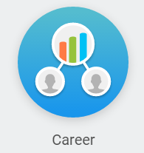
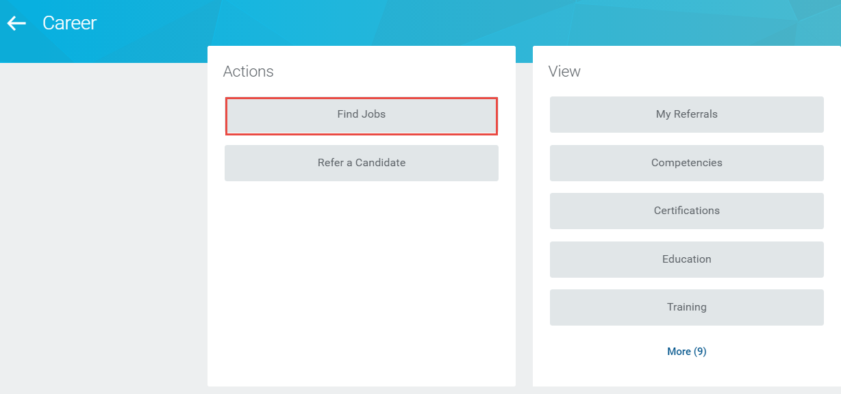
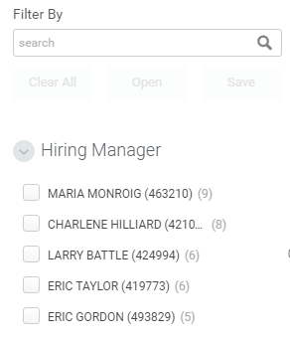
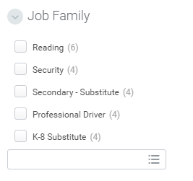
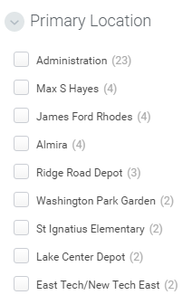
Career Worklet to Find Jobs
Use filters to
narrow your search:
Hiring Manager
Job Family
Location
Notes:
SHOW the Career Worklet.
SAY:
“Use the Career Worklet to find Job Openings at CMSD.
SHOW and SAY:
Click on Find Jobs. Then use the filters to narrow options by Job Family, Job Profile, Hiring Manager, Location, and Part Time/Full Time.”
There are no jobs to view now in the training system, but all open positions will be viewable from the Career Worklet when we Go Live in December. Use the Job Aid on Getting Started if you need additional help with your search.

Slide 12

Just for Fun…
Because Workday calculates benefit deductions for both 10 & 12 month calendars, employees will enjoy no more ________ _____________!
Your Emergency Contact information has changed. What is the correct action(s):
  Contact HR with the updated information so they can make the change
  Go into Workday and make the change yourself.
Notes:
POP QUIZ!
No more Double Deductions in the summer months!!!
2. B: Go into Workday and make the change yourself.
Workday is an Employee Self Service tool. You can complete many actions on your own, ensuring that information is correct.

Slide 13
Pay Worklet & Payroll Management
Learning Objectives:
At the end of this module you will be able to…
Use the Pay Worklet to locate your payslips, supplemental pay history & tax documents
Use the Pay Worklet to change your direct deposit and paycard information
Notes:
PAY WORKLET [See Instructions for Activity 2]
Under Pay VIEW:
QUICKLY SAY/SHOW:
View Payslips
This is where your payslips will appear.
Handout: new payslip
Review payslip with participants.
Point out itemized supplemental pays, employer paid benefits, and employee benefit deductions.
Supplemental pay items appear as separate line items.
SAY: We will no longer mail pay slips. Your old pay slips will not be in Workday, but you can view them from ESWeb.
Bonus & One Time Payment history
This is where supplemental pays and differentials appear.
My Tax documents (W4s)
This is where you locate your W4s
These will be mailed in 2017. After that you will need to access them from Workday.
Under Pay ACTIONS:
SAY:
“Employee Self Service means that you can make updates to your tax withholdings, add or change direct deposit information, and a host of other things.”
“You can change your tax withholding elections from Actions > Withholding Elections.
You can change your direct deposit or paycard information, and add additional accounts from Actions > Payment Elections. You can have up to 10 accounts.”
Your current direct deposit accounts will be carried over to Workday. You do not need to do anything unless you want to add or change an account.
“Watch the Getting Started videos for more detailed information on how to make these changes.”

Slide 14
Just for Fun…
Will pay slips be mailed to your home address if you make a special request?
What will you need to do to ensure your current direct deposit or paycard accounts are in Workday?
How many direct deposit accounts can you have?
Notes:
No—CMSD will no longer mail your payslips. You will need to go into Workday to view them.
Nothing. Your current accounts will be carried over into Workday from the current system.
Bonus! You can have up to 10 direct deposit accounts.

Slide 15

Payroll Process Overview
Every 2 weeks
Every 2 weeks
Every 2 weeks
Day One
Daily
Confirm personal info & payroll elections
Submit time
Approve time
Get paid
Enter time worked
Submit time
$
YOU
YOU
YOU
MGR & TK
YOU
Anytime, 24/7, view real-time information & make updates…
              Your payslips
              Your payroll elections
              Your work time
              Your leave balances
Notes:
Let’s take a look at the Payroll process so you know how Payroll knows what to pay you for. Workday puts the accuracy of your paycheck in your hands—here’s how…

Slide 16
Time Tracking
Learning Objectives:
At the end of this module you will be able to…
Understand CMSD’s policy for tracking your time worked
Recognize the time tracking style for your job profile
Enter your time worked, according to your job profile
Add supplemental pay when applicable
Correct entered time if you have made a mistake
Notes:
Time Tracking (45min)
[See Activity Instructions #3]

Slide 17
CMSD Time Tracking Process
Workday will allow employees to be paid accurately and on a timely basis.
All employees will report their time worked.
Time entries must be accurate. It is the responsibility of the employee to ensure accuracy. Employees must submit the actual time worked.
Time entries should be made on a daily basis.
Time entries will be submitted for Manager approval and paid every two weeks.
Time entries will be validated by Timekeepers or Managers.

Slide 18
CTU Teacher, Para & RSP Time Process
Check in for regular time worked (web calendar)
Enter supplemental time and additional details (web calendar)
Employee
Certification of effort
Submit time
DAILY
BIWEEKLY - Friday
Validate time
Approve
Send back with comments
Deny
Timekeeper
BIWEEKLY - Monday
Approve time
Approve
Send back with comments
Deny
Principal
BIWEEKLY - Tuesday
Payroll
Pay for time worked
BIWEEKLY
Notes:
Say:
This is the time entry work flow for CTU members including Teachers, Paras and RSPs. Let’s talk through the workflow first and then we will go into the system and practice entering time. (review by swimlane)
Teachers, Paras and RSPs use Workday’s Web Calendar to check in for regular time worked. Regular time is entered as a day.
To be paid for Supplemental activities including class coverages and PD, you must enter this work in Workday. These entries should be made in the web calendar daily. We will practice this in a moment.
Bi-weekly (every other Friday) you will submit your time worked and confirm certification of effort.
Time worked is then sent to the Timekeeper (Secretaries) for validation which they complete on Monday.
Time is sent for Manager approval on Tuesday. Upon approval the time entry is forwarded to payroll for payment.

Slide 19
CTU Time Tracking Demo
Enter Regular Time worked
Enter Supplemental Pay
  Class coverage
  Professional Development
Auto fill from Previous Week
Enter Time for Split and/or Multiple Jobs
Submit Time
Modify time before submitting
Modify time after submitting
Notes:
[See Activity Instructions #3—CTU]
Background:
Time is recorded with the Web Calendar as 1 day.
In addition to regular pay, Supplemental Pay is recorded in the Time worklet by specifying the appropriate Time Type. Supplemental Pay options are configured to show only those relevant to your job type.
CTU members are able to correct time entry errors without assistance if time has not yet been submitted.
Regular Time Worked: Checked In
Note: Check in is a Workday-delivered term. You are not physically checking in at an exact time. Rather, you are indicating you worked for the regular work day.
Supplemental Pay:
Class Coverage:
Add Unit—how many class coverages of that type did you do that day?
Details: Enter periods covered and name of teacher you covered for
Teachers could have multiple class coverages in a day, of different types
Professional Development:
Enter Session Name, Session Number, location and time
Autofill from previous week—it is suggested that you do not check the “Copy Details & Comments” box if you have supplemental pay from the prior week.
Split and Multiple Jobs (for Tutor)
Select Position
Select Time Type > Time Entry Code > Regular Worked Time
Enter Hours worked
Submit Time—on Friday paydays
Modify Time
Modify Time before submitting—click on entry in Web calendar and modify
Modify Time after submitting—Ask Timekeeper for assistance

Slide 20
Just for Fun…
You notice you made a mistake on your time and you have already submitted it for approval.
What should you do?
Contact Payroll—they can fix it for you.
Go into Workday and fix it yourself.
Contact your Timekeeper or Manager and ask them to send it back to you for your correction.
Notes:
If you have submitted it, you must contact your timekeeper and ask them to send it back or revise it for you.

Slide 21
Questions?
What went well?
What was difficult?
What questions do you have?

Slide 22
Time Off
Learning Objectives:
At the end of this module you will be able to…
Request sick time using the appropriate system
Request vacation time and/or special privilege days
View Time Off Balances
Submit a Leave of Absence request
Notes:
[See Activity Instructions #4]

Slide 23
Demo Time Off Worklet for CTU-- RSPs
Time Off Worklet > View
My Time Off (your time off requests from SmartFind Express)
Time Off Balances—view you balance as of a certain date
Available balances as of now
Time Off Worklet > Request
Request time off
Cancel Request
Correct approved time off requests
Notes:
Say:
All CTU members can enjoy viewing accurate Time Off balances from Workday at any time. Let‘s take a look at what we can see and do from this worklet.

Slide 24
Teacher & Para Time / Time Off Summary
Base Pay
Using Workday Web Calendar, enter “1” for each day worked. (Save)
Select “Submit” every two weeks in the Time Calendar
Manager approves submission
Base Pay will be paid in biweekly paycheck
Class Coverage
(Supplemental Pay)
Using Workday Time Calendar, select type of class coverage from drop down
Enter number of units worked for that class coverage type, periods covered and teacher’s name
Select “Submit” every two weeks in the Time Calendar. *MUST SUBMIT TO RECEIVE PAYMENT
Manager approves submission
Class Coverage will be paid with Base Pay in next paycheck after approval
Professional Development
(Supplemental Pay)
Using Workday Time Calendar, select type of PD from drop down
Enter date, time, session number and session name
Select “Submit” every two weeks in the Time Calendar. *MUST SUBMIT TO RECEIVE PAYMENT
Manager approves submission
Professional Development will be paid with Base Pay in next paycheck after approval
Time Off
Request Substitute in SmartFind Express
Time off flows automatically to Workday Time Off calendar
Verify Time Off request is accurate in Workday
Manager approves submission
Sick Leave balance is adjusted and shown on pay slip
Notes:
This is a recap of the Time Tracking and Time Off Process for Teachers and Paras.
HANDOUT: Fast Facts for CTU members.

Slide 25
Just for Fun…
Which worklet allows you to request Time Off?
Where can you find your leave balance?
In what increments of time can you take sick and vacation time?
Notes:
Time or Time Off Worklet
Time Off Worklet
Any

Slide 26
Questions?
What went well?
What was difficult?
What questions do you have?

Slide 27
Mobile
Go Mobile!
Employees can use the mobile version of Workday for many functions. Use the Job Aid to download and get connected.
Note: Some functionality may not be available on the mobile app.
Notes:
SAY:
Employees can use the mobile version of Workday for many functions.
Use the Job Aid out on Getting Started to get connected with mobile!
Note: Some functionality may not be available on the mobile app.

Slide 28
Final Steps
Employee Self Service
Notes:
SAY:
Let’s begin to wrap up and review final steps.

Slide 29

Coming Attractions
July 1, 2017
Finance & Procurement
Talent/Performance
  for CRESS and
  Non-bargaining
  employees
Notes:
SAY:
Finance & Procurement is coming on or before July 2017.
Non-bargaining and CRESS employees will be using the Performance module for upcoming performance evaluation process.
CRESS: Classified Represented Educational Support Staff (ie: cleaners, food svc, transport, laborer)

Slide 30
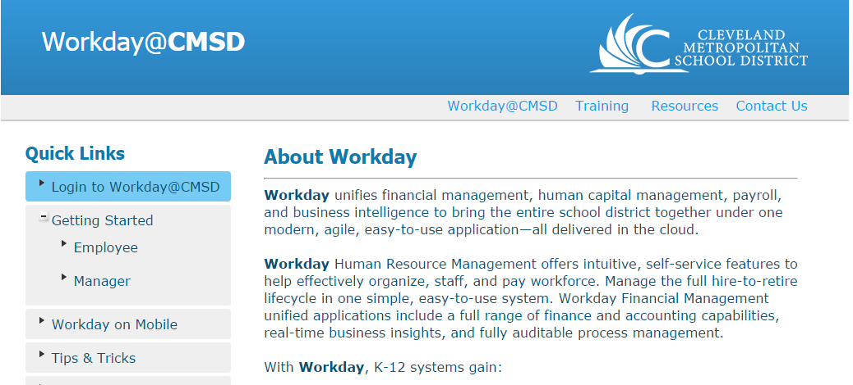
How to access Workday at Go Live!
When we go live, you will use your CMSD Network Password to log in.
Important: For shared computers, be sure to log out after using!
Notes:
SAY:
Today we were in the Training system. When we Go Live, you will access the Production System from this link on the Workday Website.

Slide 31
Go- Live Checklist
To-Dos at Go-Live:
Day One of Go-Live
Log in and enter your time worked
Update your personal info including emergency contact info
Validate your direct deposit or paycard information
Validate info on your position title and org structure
  Not correct? Use “Contact Us” to let us know!
Ongoing
Enter and submit your time worked for your manager approval
Notes:
Review slide…

Slide 32

Getting Help
Notes:
SAY:
What if you get stuck?

Slide 33
Where to go for help
For log in assistance
CMSD Service Desk
For questions on how to use Workday
The Getting Started pages on the Workday Website
  Videos, job aids and more!
Your manager or the Workday Point Person for your area
Workday Support Network Members
For corrections on organizational data in Workday, system breaks, & to make suggestions for improvement
The Workday Website > Contact Us
Notes:
Review slide…

Slide 34
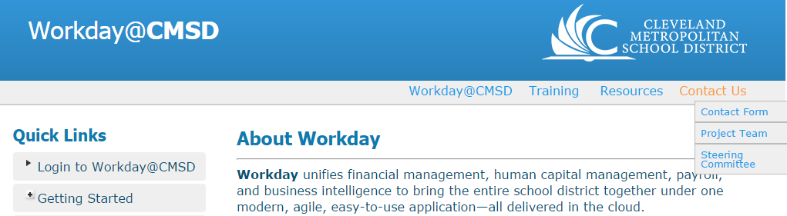
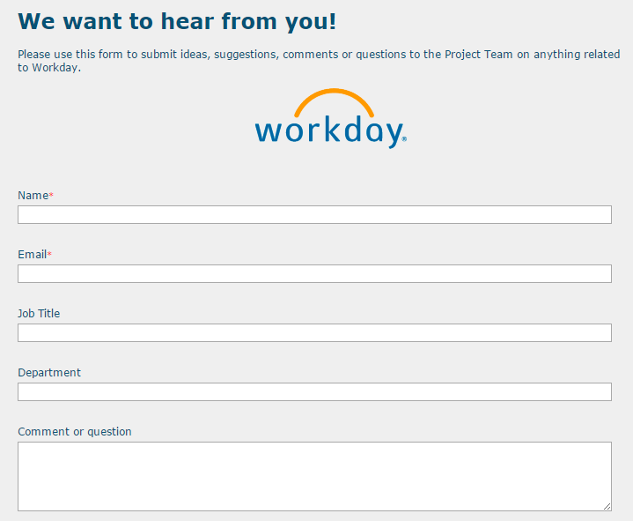
The Workday Change Request Process
Have a suggestion to improve Workday at CMSD?
Use our webpage to Contact Us…
Notes:
Review slide. This is what the Contact Us form looks like.

Slide 35

Graduation
Thanks for your participation. Your training is complete when you finish these items:
Online Class Evaluation—how did we do?
Training-Sign Off—your graduation step!
The Training Evaluation link is on the Training tab of Workday web page.
The Training Signoff is a hardcopy document—get this from your trainer.
Notes:
SAY:
Thank you for your participation! We look forward to continuing the journey as together we prepare for this new tool!
One final step before class is done…a sort of formal graduation step and to help us continue to improve. Please complete the class evaluation and Training-sign off.
The Evaluation can be found from the Workday Webpage>Training tab > Training Evaluation link.
The Training Sign-Off link is a simple acknowledgement statement.

